Slide 1

2N Clip 2wire-IP
The power of IP via 2 wires

Slide 2
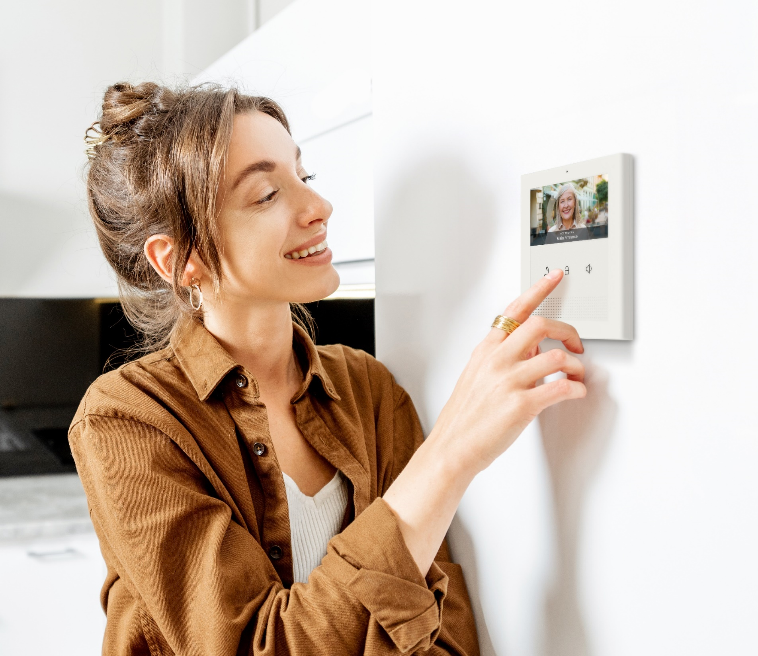
2N Clip 2wire-IP
Bring a meaningful upgrade to the retrofit market, not just a routine replacement. The 4″ display IP indoor station delivers high-quality video and connects directly to existing legacy cabling.

Slide 3
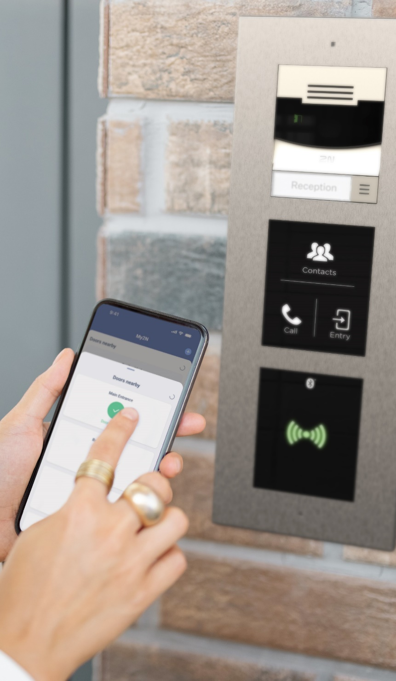
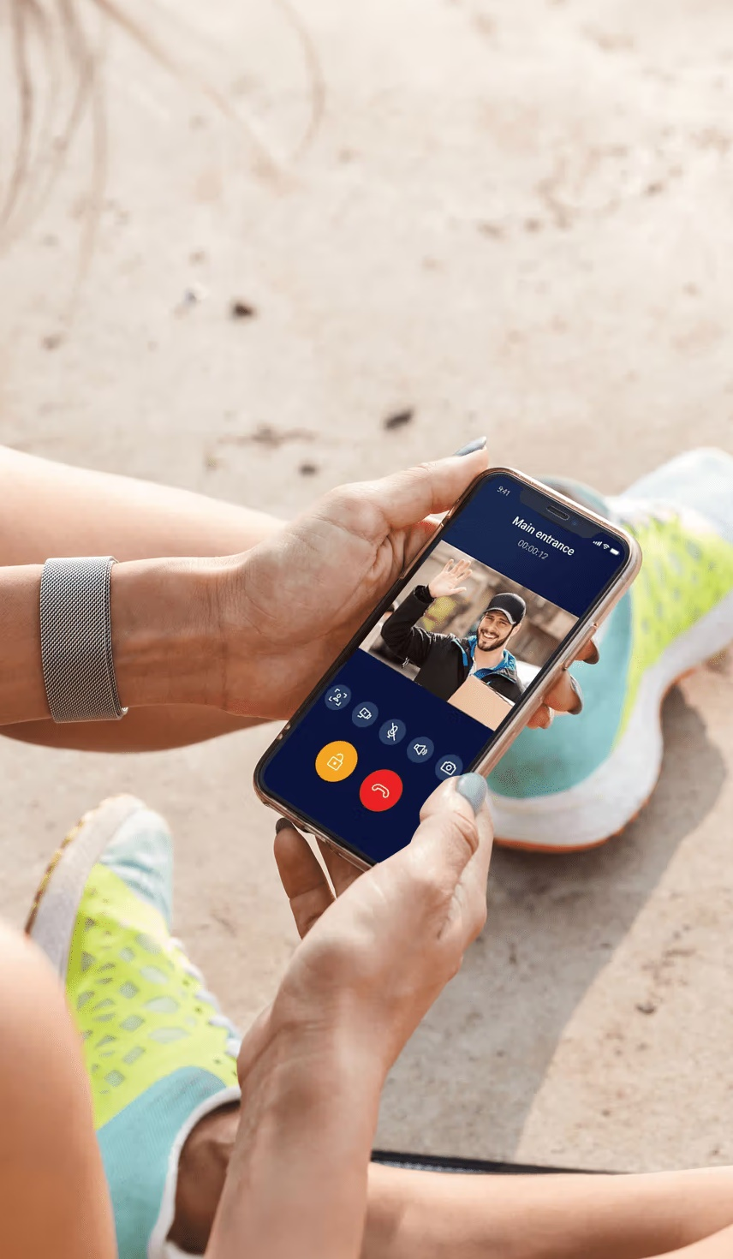
Enhance the resident experience
Combine 2N Clip 2wire-IP with other parts of 2N’s solutions and offer features like convenient mobile access or our handy intercom to mobile phone calls feature.

Slide 4
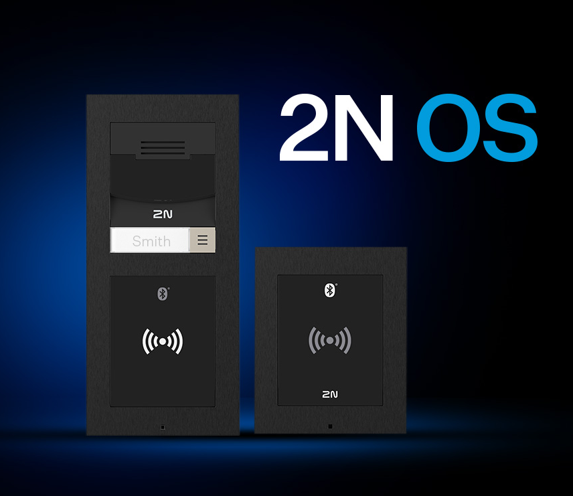
Advantages of a pure IP product
Even when connected to legacy cabling, this product delivers all the advantages of an IP-based system, including the level of reliability you expect from 2N OS-based products.

Slide 5
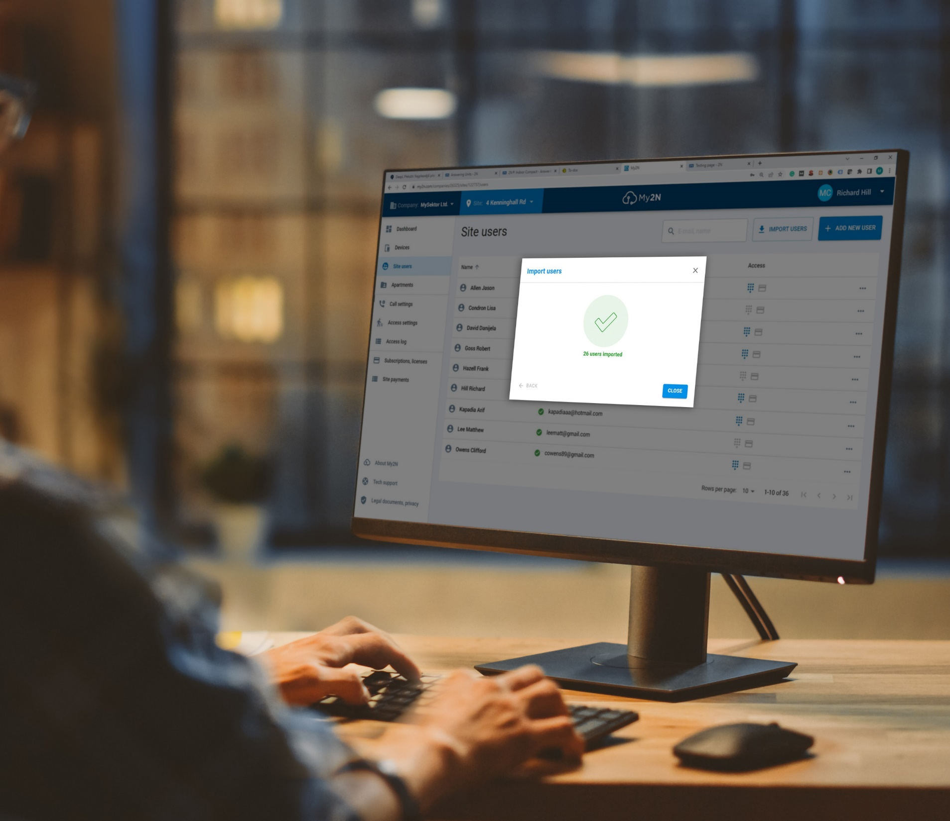
Remote management
9 times out of 10 you can handle your customer requests from your home or office, significantly reducing travel time and costs.

Slide 6
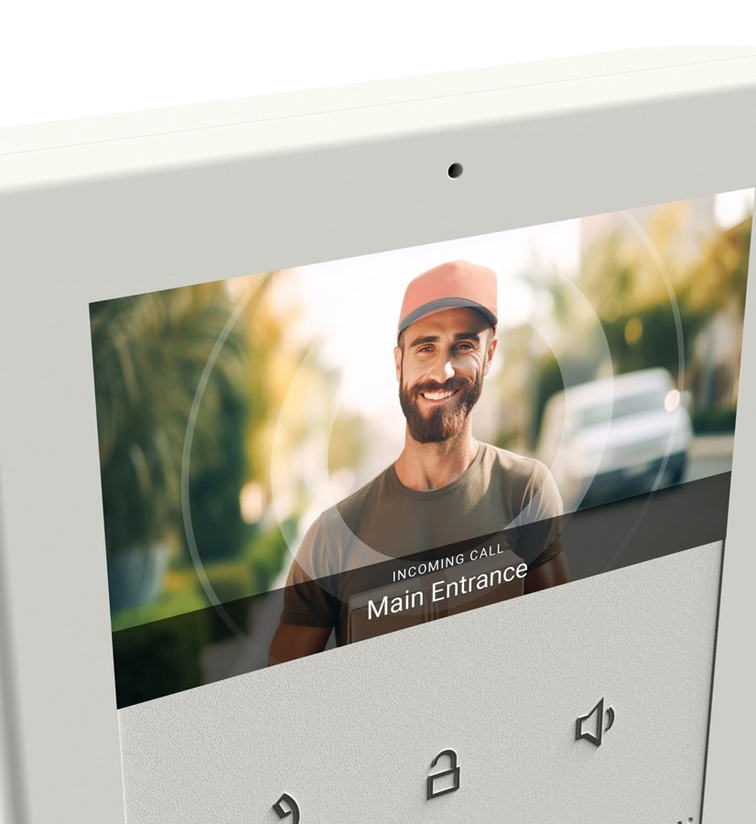
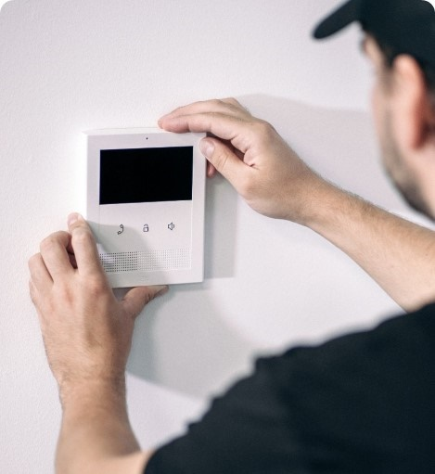
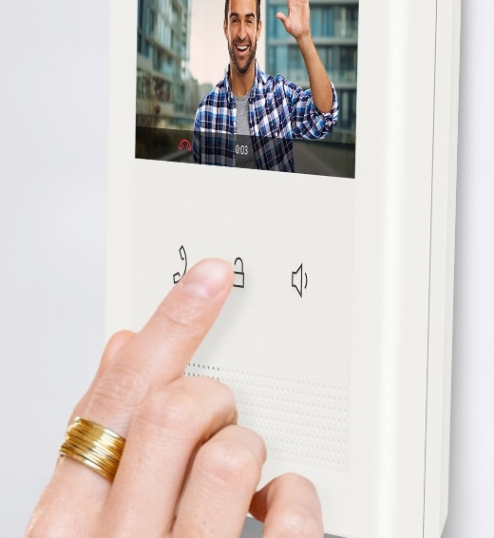
Upgrade to IP video
Fast track installation
Easy to operate
HD video provides clear visual identification of visitors, and it’s less prone to signal interference.
Just drill in two screws, connect the legacy 2wire cables, and clip the 2N Clip to the wall.
There are only three clearly visible buttons, making the device easy to use even for older people.

Slide 7

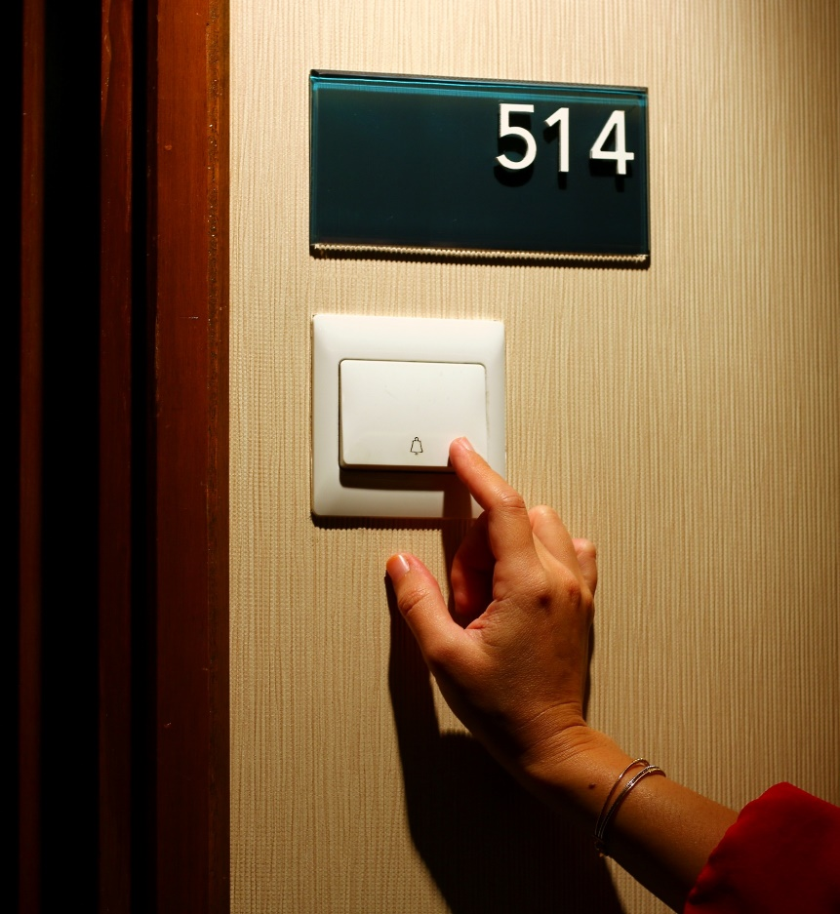
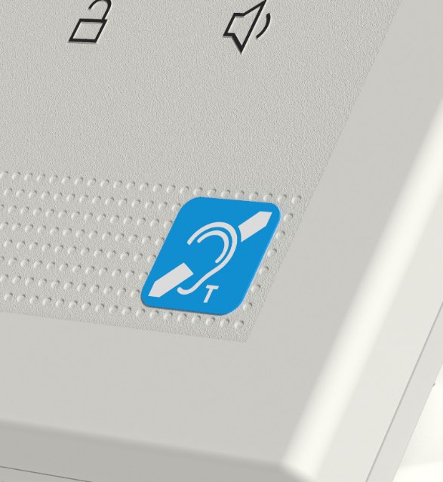
Built-to-last
Doorbell button support
Integrated induction loop
High-quality materials and European craftsmanship assure extraordinary longevity.
Connect the doorbell button directly to the 2N Clip 2wire-IP and cut installation costs.
Choose a variant with a built-in induction loop for projects where accessibility is a priority.

Slide 8
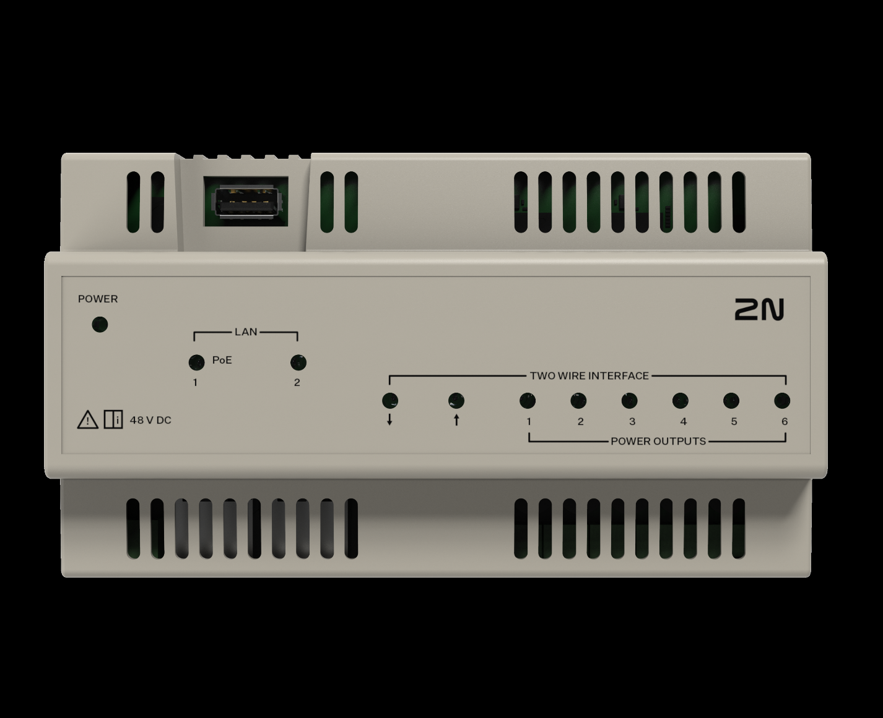
Switch it on
To install the 2N Clip 2wire-IP indoor station, you’ll need one 2N Clip 2wire-IP Switch per floor or every six units. If needed, Switches can be daisy-chained to cover more floors and apartments. Each switch needs a dedicated external power supply.

Slide 9
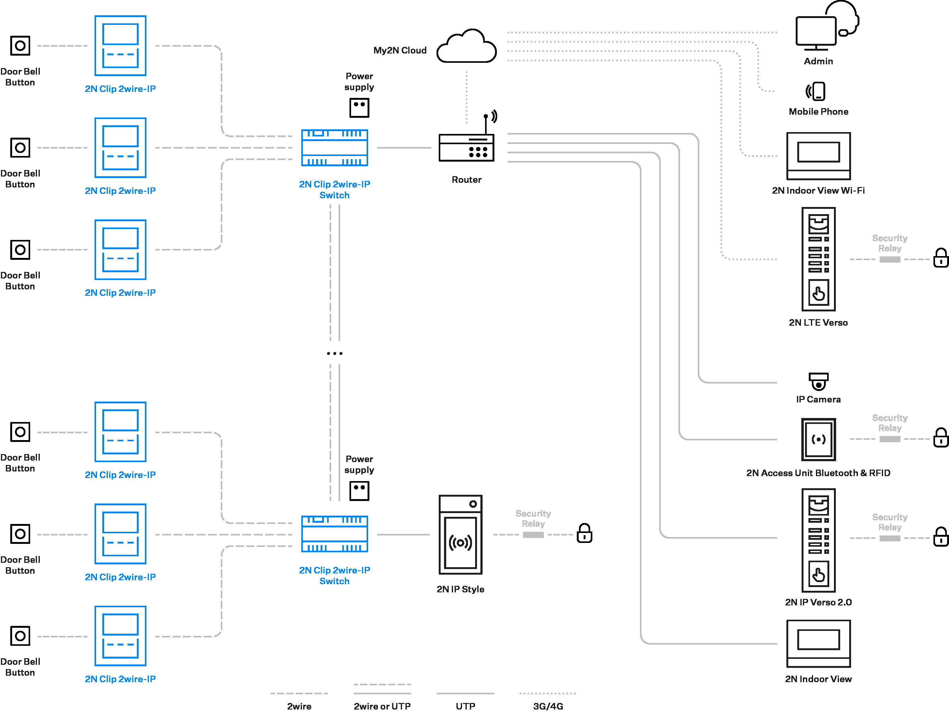
Connection scheme

Slide 10
Technical parameters 2N Clip 2wire-IP
Power supply
Type | 2wire-IP powered, 48 V DC, 200 mA
User interface
Controls | 3 capacitive buttons
Operation | press and hold the RESET button to restore factory settings
Audio
Microphone | integrated
Speaker | integrated, 2W
Integrated induction loop | optional
Codecs | G.711a/u, G.722, G.729, L16/16 kHz
Video
Display size | 4.3" colour display
Resolution | 480x272 pixels
Codecs | H.264
Interface
Two wire | 2wire-IP
Recommended cabling | 1 pair of Cat3 or higher, 24AWG
Important note | always verify condition of the legacy cabling before use
Doorbell input
Input type | switching contact (button/relay)
Contact type | normally open (NO)
Contact parameters | 12V/20mA, DC
Mechanical properties
Dimensions (W x H x D) | 4.88 x 5.91 x 1.10 in
Weight | 0.52 lb
Operating temperature | 32 to 122°F
Storage temperature | -4 to 158°F

Slide 11
Technical parameters 2N Clip 2wire-IP Switch
Power supply
Type | external source, 48V DC, 1,92A
Interface
Two wire | 6x 2wire-IP (max. 10Mbps data) powered for connection of 2N Clip 2wire-IP
 | 2x 2wire-IP (max. 100Mbps data) passive for connection of another 2N Clip 2wire-IP Switch
LAN | 2x 100Base-TX, RJ-45
PoE | one LAN port providing 802.3af Class 0 (up to 25W)
USB port | unused (for service purposes only)
Recommended cabling | Cat5e or higher, 24AWG
Important note | always verify condition of the legacy cabling before use
Mechanical properties
Dimensions (W x H x D) | 155 x 88 x 59 mm
Weight | 313 g
Operating temperature | -10 to 50°C
Storage temperature | -20 to 70°C
Relative operating humidity | 10 to 90 % (non-condensing)
IP rating | IP20
Recommended altitude | 0 to 2000 m
Mounting | DIN-rail mountable into the electrical switchboard
Mechanical properties
Dimensions (W x H x D) | 6.10 x 3.46 x 2.32 in
Weight | 0.69 lb
Operating temperature | 14 to 122°F
Storage temperature | -4 to 158°F
Mounting | DIN-rail mountable into the electrical switchboard

Slide 12
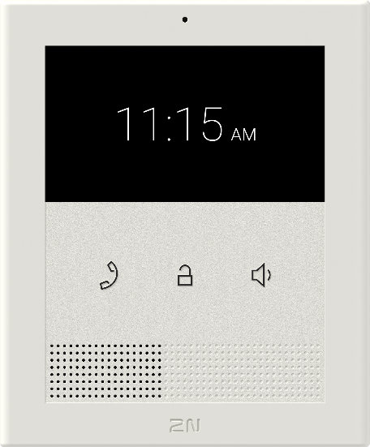
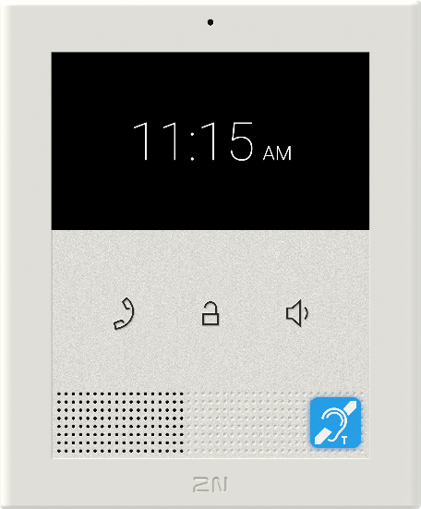
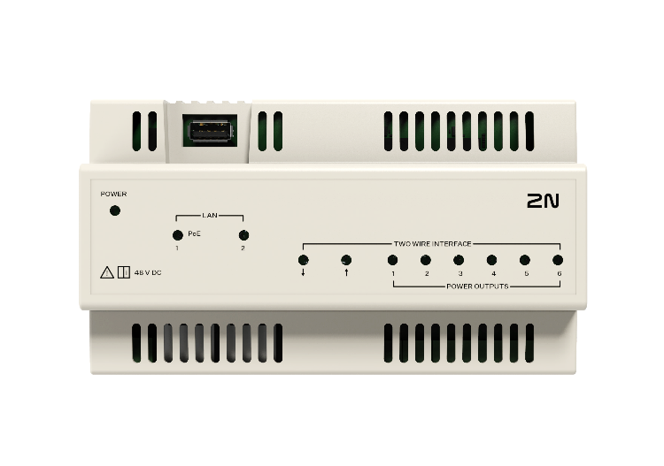
Order numbers
2N Clip 2wire-IP
2N Clip 2wire-IP, Induction Loop
2N Clip 2wire-IP Switch
03448-001
03449-001
03450-001

Slide 13
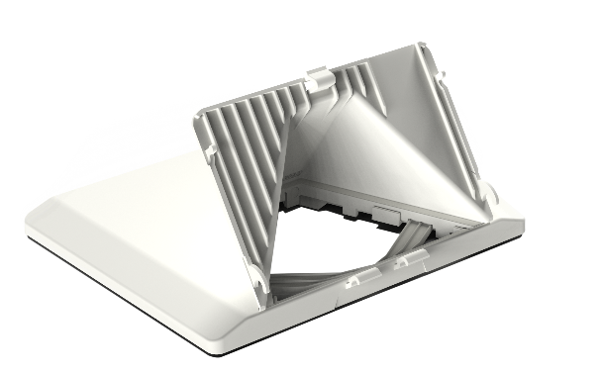
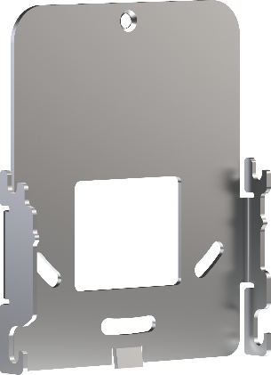
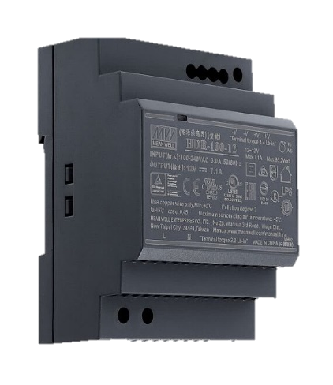
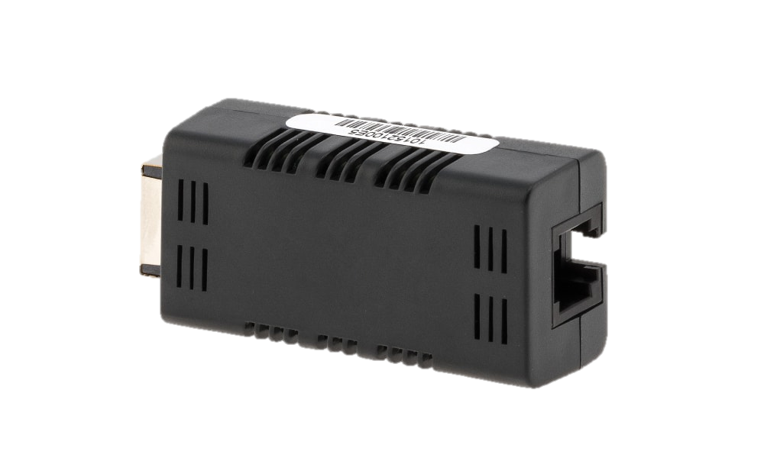
Order numbers
2N Clip Desk Stand
2N Clip Single-Gang Box installation plate
Power Supply 2N Clip 2wire-IP Switch
NVT PhyLink Adapter
02905-001
02905-001
03479-001
02319-001 (six-pack)

Slide 14
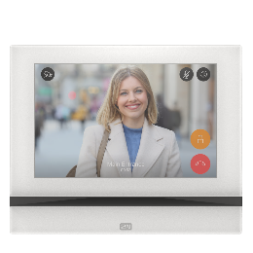
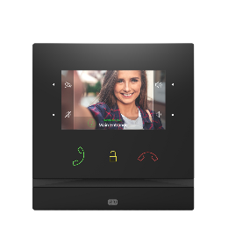
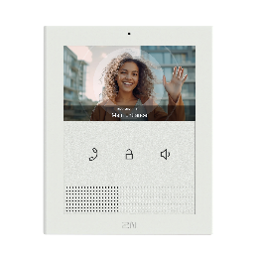
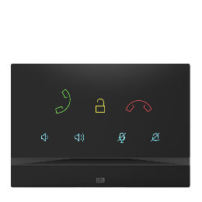

Indoor station portfolio
High-end 7” full screen
High-end 4” video
Cost effective video (newbuilt and retrofit)
Premium audio only
Mobile

Slide 15
Don‘t replace, upgrade

